Slide 1

Chapter 3: R Basics & Statistical Analysis
Getting Into R,
Getting Data Into R & Out of R
Performing Analyses in R & Deducer

Slide 2
Cleaning jobs
Is the data rectangular? (i.e., structured)
Are there missing values? Do what?
Are there many zeros when there shouldn’t be? Do what?
Are there more variables than needed for analysis?
Does the data need to be reshaped? Stacked?
Is recoding needed?
Is binning necessary?

Slide 3
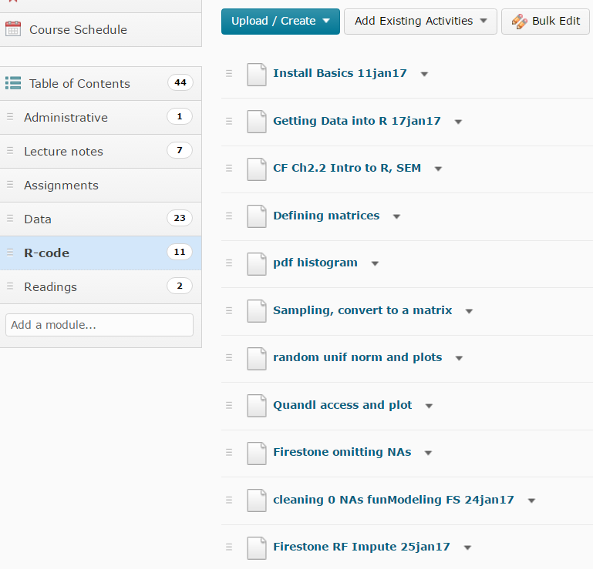
Cleaning R-code in Avenue

Slide 4
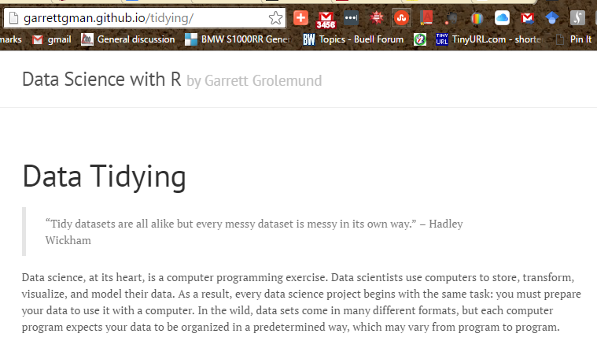
http://garrettgman.github.io/tidying/

Slide 5
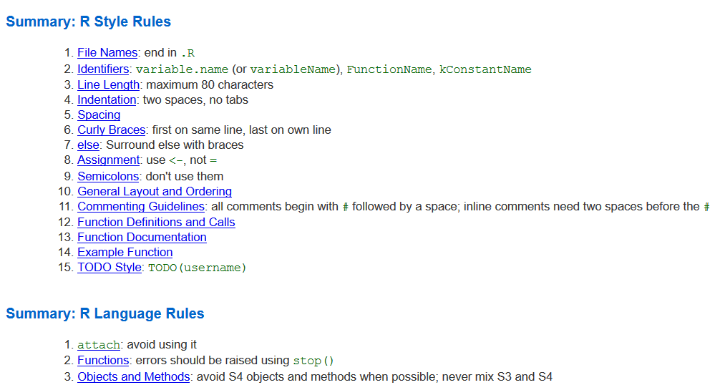
FYI: Google’s R style sheet
https://google-styleguide.googlecode.com/svn/trunk/Rguide.xml

Slide 6

Firestone Canada Data Attempting to Predict Likelihood of Returning for Automotive Service: based on attitudes regarding customers’ most recent visit
Used with the permission of Firestone Canada
EMBA.McMaster.ca

Slide 7
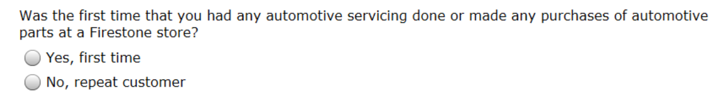
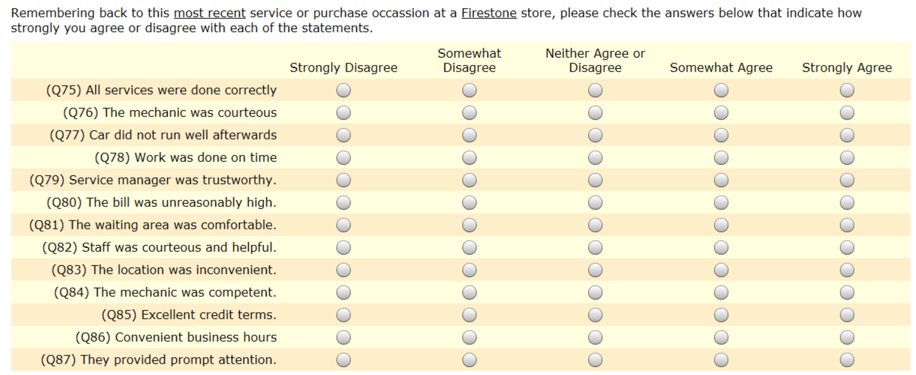
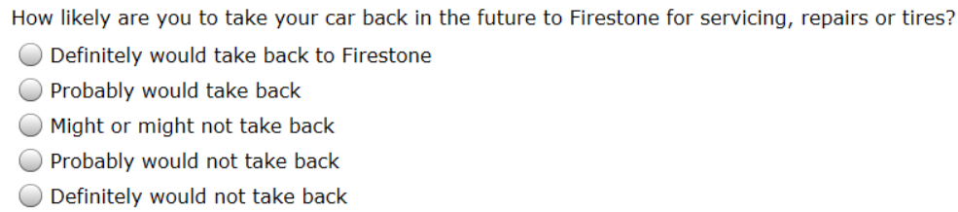
Firestone Canada Questionnaire (used with permission of Firestone Canada … greatly reduced in size.)
1
2
Q045
2
3
4
5
1
NB: some of the variables were stated in the negative. These were ‘turned around’ so that the coefficients would be positive.
5
4
3
2
1
Q088

Slide 8
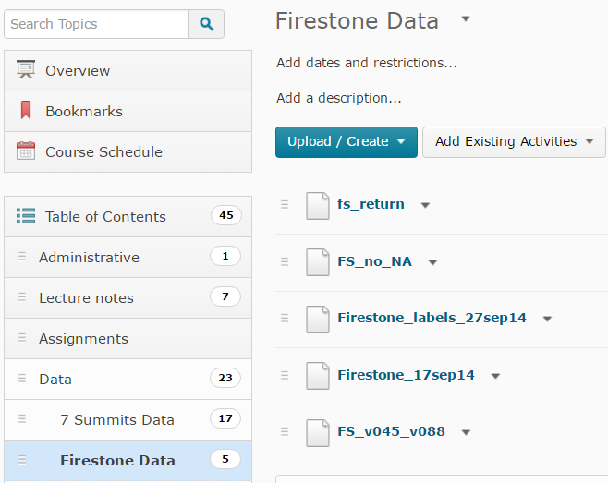
Firestone data in Avenue

Slide 9
What is the Information Content of the Data?
Ratios
Ratio
Metric
Intervals
Interval
Ordering
Ordinal
Non-Metric
Naming
Nominal

Slide 10
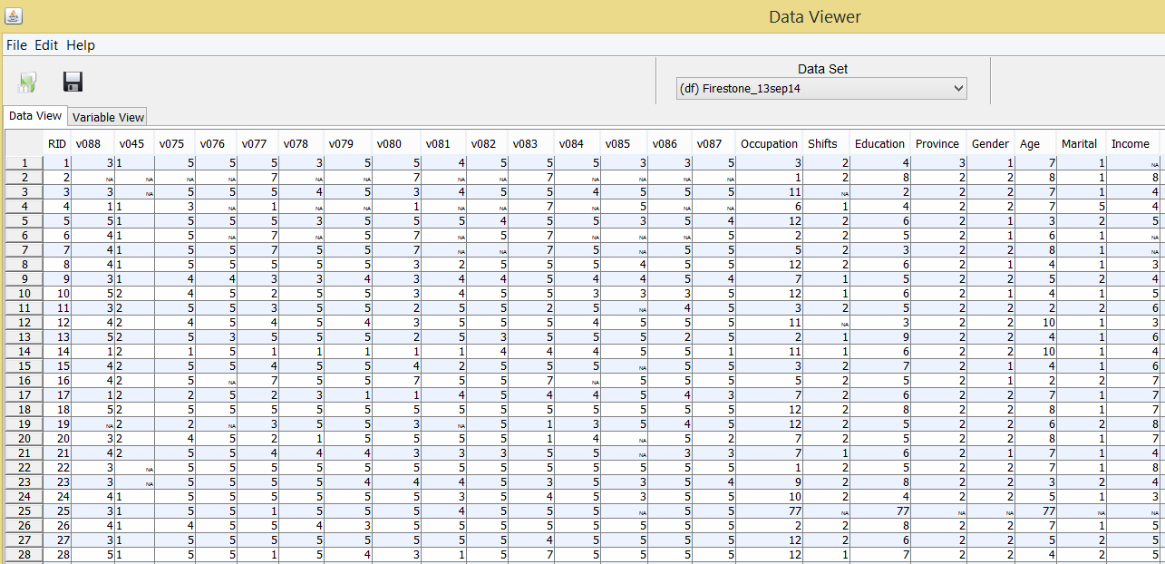
automotive service

Slide 11
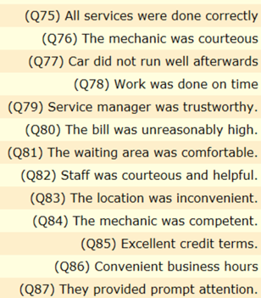
Automotive service
Person (respondent) #1
Variable – v088, likely to return
1
2
Q045

Slide 12
Demographics

Slide 13
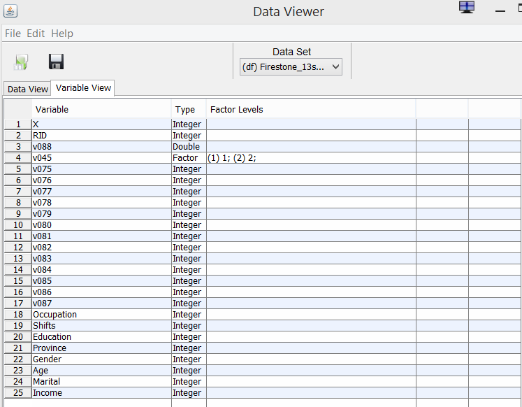
Inspecting data in Deducer

Slide 14
Overview
What’s the nature of the data that I need to analyze?
What’s it look like?
Can I work with the data as it is? Or, do I need to clean it?
What did I expect before obtaining the data?
Does the data match my expectations?
Measures of central tendency
Measures of variability
Graphical descriptives

Slide 15
START HERE 01feb17

Slide 16
The eoda Top 10 R-Packages
https://blog.eoda.de/2017/01/28/on-occasion-of-the-10000th-r-package-the-eoda-top-10/
Hmisc: This was one of the first R packages to be used at eoda on a regular basis. Today we barely use Hmisc anymore but nonetheless it had to be part of our top 10 simply for nostalgic reasons.
data.table: R as an in-memory database with data.table? Who said R was slow?
TraceR: Excellent profiling package. Will find every bottleneck.
dplyR: Not only fast when it comes to evaluation but also easy to master. Intuitive data management with R has a name – dplyR.
ggplot2: A guarantee for easily creating descriptive graphics.
magrittr: %>%. The pipe operater %>% turns complicated nested function calls into readable chains.
shiny: Interactive web application where programming in HTML and JavaScript can be done with little effort.
tidyr: Very good functionality for restructuring data. Particularly remarkable: the functions gather and spread for converting data from long to wide format or from wide to long format.
caret: This package unifies the data mining algorithms in one interface.
rcpp: A package that we don’t use extensively ourselves but is nevertheless indispensable in our top 10 list because it is an important component of many other great R packages.
We are already curious to see which R packages will become indispensable tools in the future and make it to the top 10 list on occasion of the 20,000th R package.
But for now, only that much: Congratulations to the world-wide R community and the R core team.

Slide 17
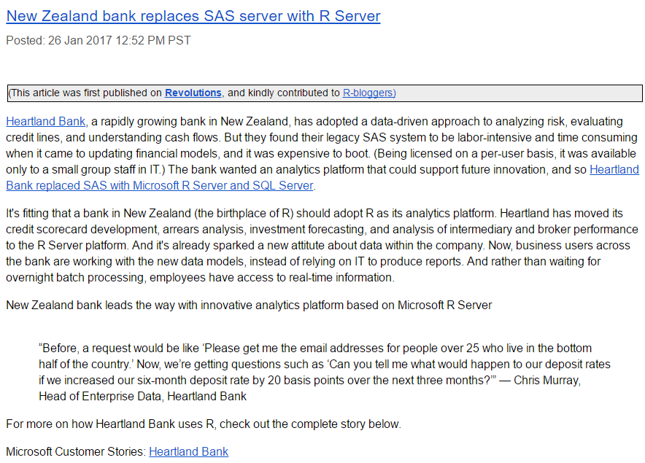

Slide 18
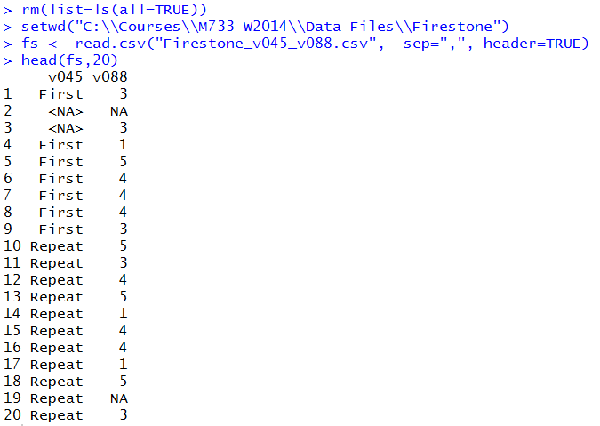

Cleaning : reading data & counting NAs
Missing values or “NA”s can be a problem
If we want to use this data in StatKey and in many R analyses, there must be no NAs.
2 refers to columns, 1 to rows
There are 43 NAs in v045 & 41 NAs in v088
We need to eliminate the NAs for StatKey

Slide 19
cleaning: omitting NAs
rm(list=ls())
setwd("C:\\Users\\Ken\\Google Drive\\Courses\\M733\\Data Files\\Firestone")
fs <- read.csv("Firestone_17sep14.csv", sep=",", header=TRUE)
head(fs,20)
apply(apply(fs,2,is.na),2,sum)
fs1<-na.omit(fs)
head(fs1)
str(fs1)
write.csv(fs1,"FS_no_NA.csv",row.names=FALSE )
names(fs)[[3]]
fs2<-na.exclude(fs)
str(fs2)
head(fs2)
na.omit(fs) omits the NAs from the fs dataframe

Slide 20
cleaning: omitting variables with 0s & NAs
rm(list=ls())
setwd("C:/Users/Ken/Google Drive/Courses/M733/Data Files/Firestone")
fs<- read.csv("Firestone_13sep14b.csv", sep=",")
## Loading needed libraries
#install.packages("funModeling", dependencies=TRUE)
library(funModeling)
head(fs)
#Checking NA, zeros, data type and unique values
my_data_status<-df_status(fs)
# q_zeros: quantity of zeros (p_zeros: in percentage)
# q_na: quantity of NA (p_na: in percentage)
# type: factor or numeric
# unique: quantity of unique values
# Removing variables with 60% of zero values
vars_to_remove<-subset(my_data_status, my_data_status$p_zeros > 60)
vars_to_remove["variable"]
## Keeping all except vars_to_remove
fs_2<-fs[, !(names(fs) %in% vars_to_remove[,"variable"])]
head(fs_2)
#Ordering data by percentage of zeros
my_data_status_2<-my_data_status[order(-my_data_status$p_zeros),]
head(my_data_status_2)
names(fs)
names(fs_2) # THESE ARE THE SAME, SO NO REMOVAL
Using funModeling
“cleaning 0 NA funModeling FS 24jan17.R”
# Removing variables with 10% of missing values NAs
vars_to_remove<-subset(my_data_status, my_data_status$p_na > 10)
vars_to_remove["variable"]
## Keeping all except vars_to_remove
fs_2<-fs[, !(names(fs) %in% vars_to_remove[,"variable"])]
head(fs_2)
#Ordering data by percentage of NAs
my_data_status_3<-my_data_status[order(-my_data_status$p_na),]
head(my_data_status_3)
Download from Avenue, open in RStudio

Slide 21
Cleaning: Imputing NAs (soft impute) “Firestone_RF_Impute_25jan17.R” in Avenue
rm(list=ls(all=TRUE))
setwd("C:/Users/Ken/Google Drive/Courses/M733/Data Files/Firestone")
fs <- read.csv("Firestone_17sep14.csv", sep=",", header=TRUE, row.names = "RID")
str(fs)
head(fs)
apply(apply(fs,2,is.na),2,sum) # find num of NAs per variable
#__Below is code for "soft imputing", easy by not the best___
#install.packages("randomForest", dependencies=TRUE)
require(randomForest)
fs.imputed <- rfImpute(RID ~ ., fs)
fs.imputed[1:20, ]
fs[1:20, ]
summary(fs.imputed)
summary(fs)
# since we got non-integer values for demographics, change to factors
This is ‘soft impute’, meaning that it works fine, but could be improved upon.
This uses “randomForest” package. Install first.

Slide 22
Imputing NAs (soft impute) - continued Firestone_RF_Impute_25jan17 in Avenue
# since we got non-integer values for demographics, change to factors
fs$v088<- as.factor(fs$v088)
fs$v088<- as.factor(fs$v088)
fs$v075<- as.factor(fs$v075)
fs$v076<- as.factor(fs$v076)
fs$v077<- as.factor(fs$v077)
fs$v078<- as.factor(fs$v078)
fs$v079<- as.factor(fs$v079)
fs$v080<- as.factor(fs$v080)
fs$v081<- as.factor(fs$v081)
fs$v082<- as.factor(fs$v082)
fs$v083<- as.factor(fs$v083)
fs$v084<- as.factor(fs$v084)
fs$v085<- as.factor(fs$v085)
fs$v086<- as.factor(fs$v086)
fs$v087<- as.factor(fs$v087)
fs$Occupation<-as.factor(fs$Occupation)
is.factor(fs$Occupation)
fs$Shifts<-as.factor(fs$Shifts)
fs$Education<-as.factor(fs$Education)
fs$Province<-as.factor(fs$Province)
fs$Marital<-as.factor(fs$Marital)
fs$Income<-as.factor(fs$Income)
str(fs)
require(randomForest)
fsc.imputed <- rfImpute(RID ~ ., fs)
fsc.imputed[1:20, ]
fs[1:20, ]
str(fsc.imputed)
summary(fs.imputed)
summary(fsc.imputed)
# But, now everything is a factor and calculations are limited
fsc.imputed$v088<- as.numeric(fsc.imputed$v088)
fsc.imputed$v088<- as.numeric(fsc.imputed$v088)
fsc.imputed$v075<- as.numeric(fsc.imputed$v075)
fsc.imputed$v076<- as.numeric(fsc.imputed$v076)
fsc.imputed$v077<- as.numeric(fsc.imputed$v077)
fsc.imputed$v078<- as.numeric(fsc.imputed$v078)
fsc.imputed$v079<- as.numeric(fsc.imputed$v079)
fsc.imputed$v080<- as.numeric(fsc.imputed$v080)
fsc.imputed$v081<- as.numeric(fsc.imputed$v081)
fsc.imputed$v082<- as.numeric(fsc.imputed$v082)
fsc.imputed$v083<- as.numeric(fsc.imputed$v083)
fsc.imputed$v084<- as.numeric(fsc.imputed$v084)
fsc.imputed$v085<- as.numeric(fsc.imputed$v085)
fsc.imputed$v086<- as.numeric(fsc.imputed$v086)
fsc.imputed$v087<- as.numeric(fsc.imputed$v087)
str(fsc.imputed)
apply(apply(fsc.imputed,2,is.na),2,sum) # find num of NAs per variable
write.csv(fsc.imputed, "FS_soft_impute_25jan17.csv", row.names=FALSE)

Slide 23
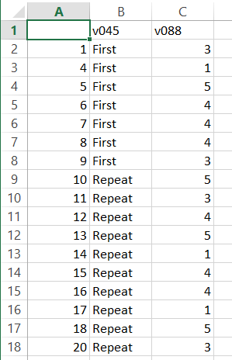
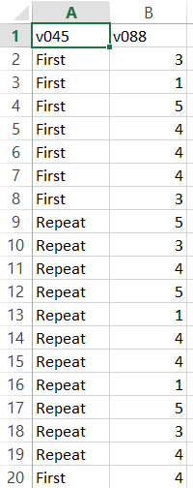
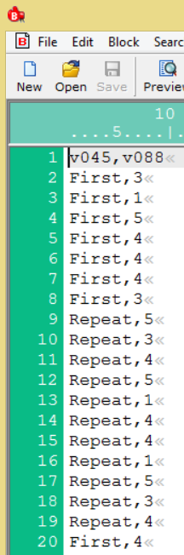
Writing (saving) file as csv
But we don’t want the row numbers
Now we can copy & paste these two columns, with the header, into StatKey.
Since you need actual commas separating the values in StatKey, I opened the file in Boxer and then copied it into StatKey.

Slide 24
Appendices

Slide 25
RCommander

Slide 26
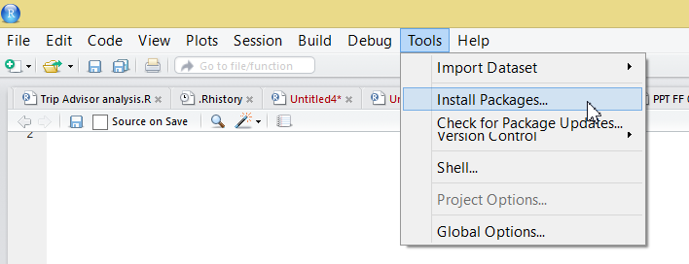
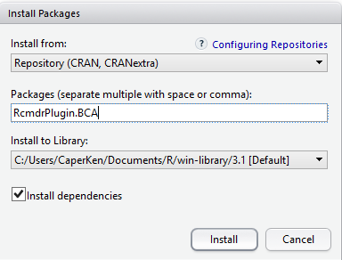
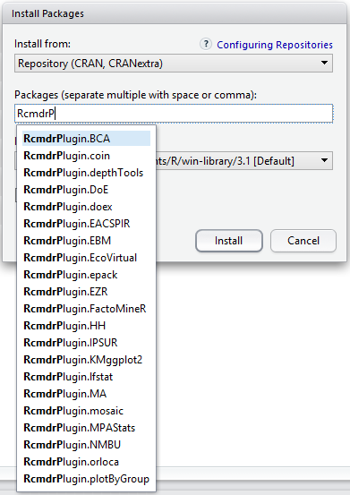
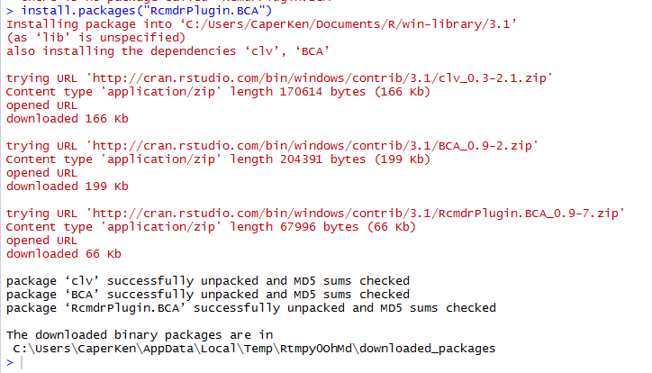
Installing Rcmdr from within RStudio

Slide 27
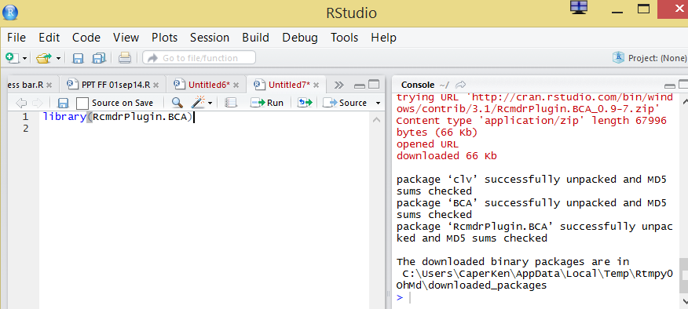

Slide 28
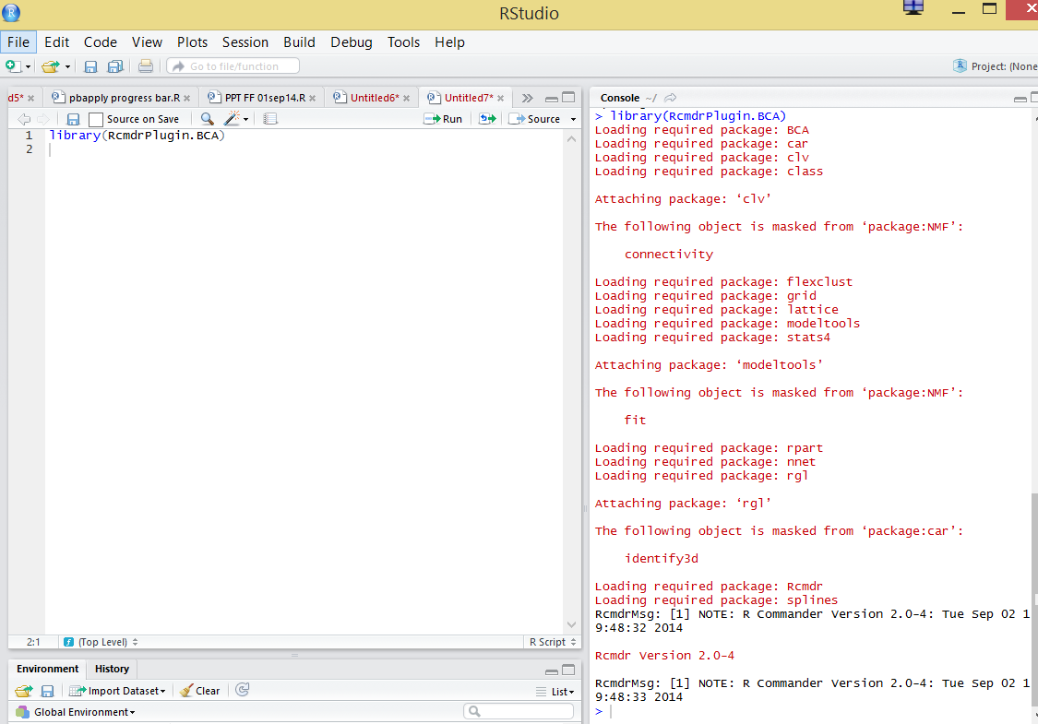

Slide 29
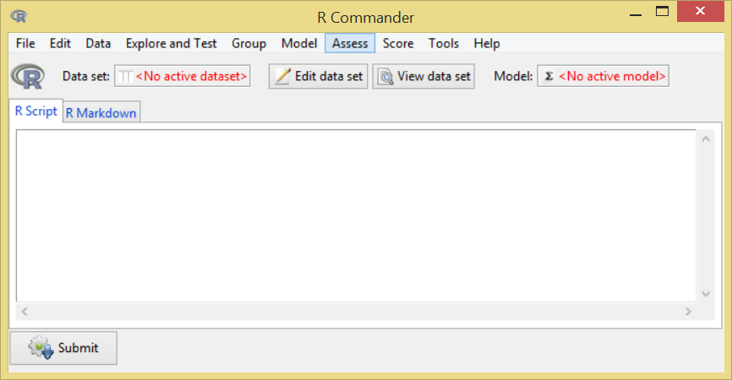

Slide 30
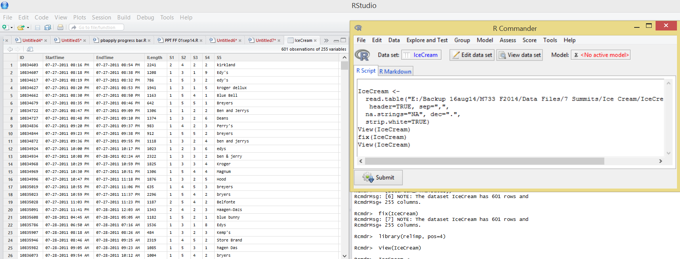

Slide 31
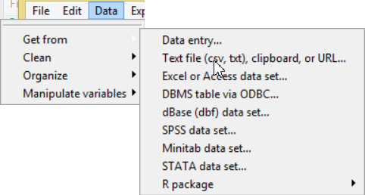
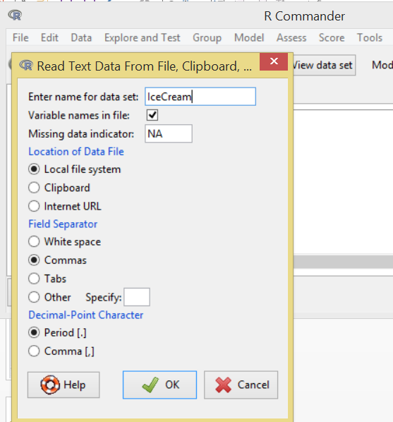

Slide 32
:: ::: | access variables in a namespace
$ @ | component / slot extraction
[ [[ | indexing
^ | exponentiation (right to left)
- + | unary minus and plus
: | sequence operator
%any% | special operators (including %% and %/%)
* / | multiply, divide
+ - | (binary) add, subtract
< > <= >= == != | ordering and comparison
! | negation
& && | and
| || | or
~ | as in formulae
-> ->> | rightwards assignment
<- <<- | assignment (right to left)
= | assignment (right to left)
? | help (unary and binary)
Syntax {base} | R Documentation

